Slide 1


Slide 2

“We are in the era of big data, and big data need statisticians to make sense of it. The democratization of data means that those who can analyse it well will win. Data is the sword of the twenty-first century, those who wield it well, the samurai.”
Eric Schmidt & Jonathon Rosenberg “How Google Works”

Slide 3

IBM “The Battle For Personalised Loyalty”
What will set winners apart?
Who has access to the most data?
Who has the best ability to garner insight & act on data?
Who can execute the best at the moment of truth?

Slide 4
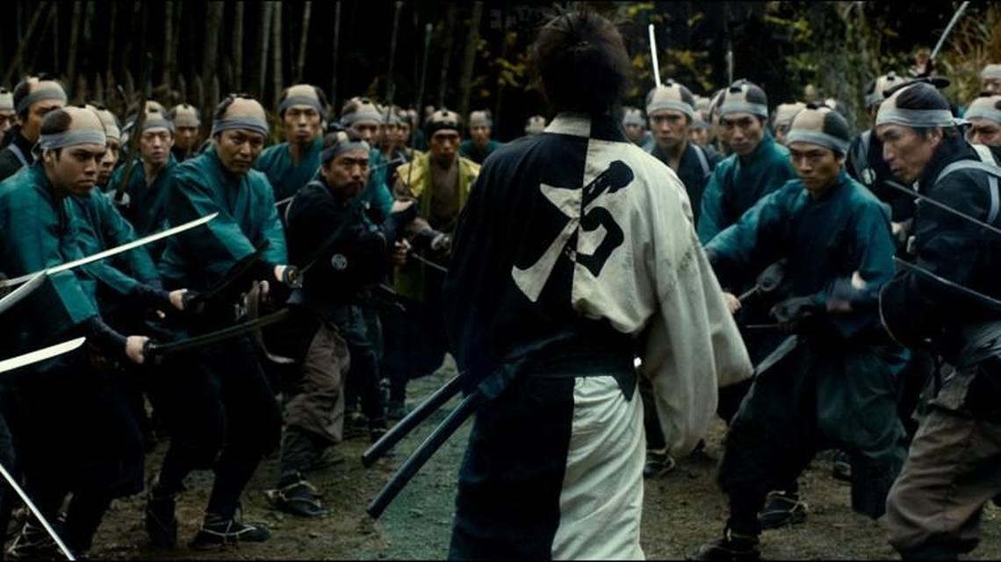
Problem……not enough Samurai

Slide 5

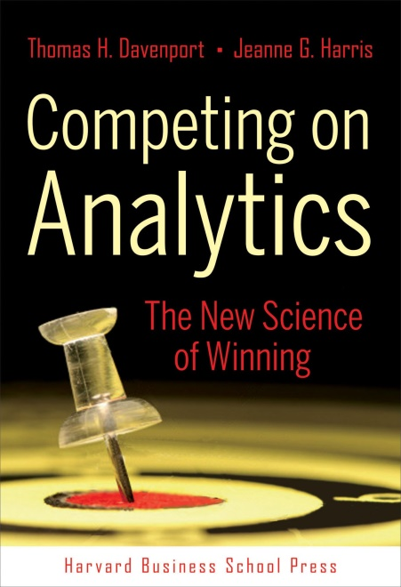
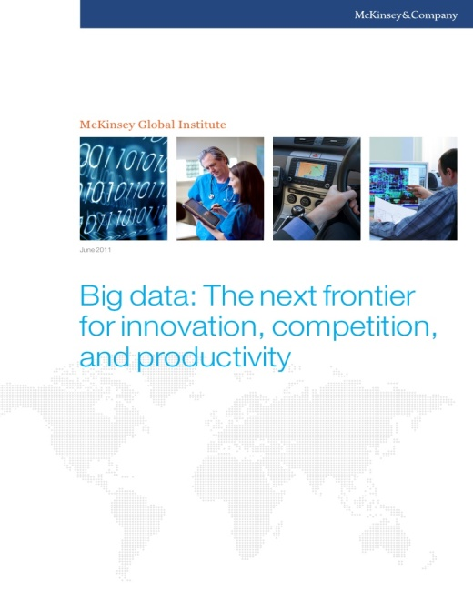
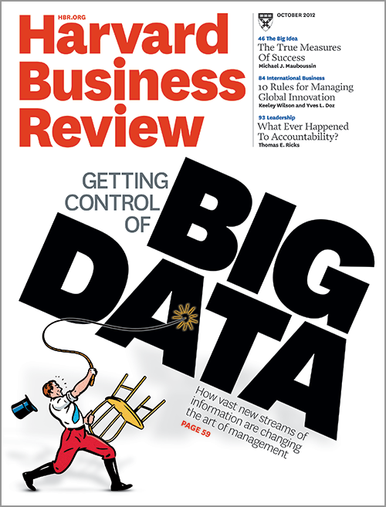

Slide 6

According to Gartner analyst Nick Heudecker, over 85% of data science projects fail.
A report from Dimensional Research indicated that only 4% of companies have succeeded in deploying machine learning models to production environment.

Slide 7

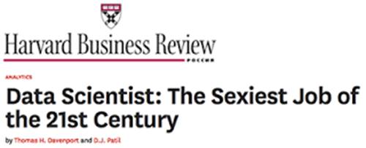

Slide 8

The average data scientist/analyst only remains in their role for around 2 years.
75% are either actively looking for a new role, or open to the right opportunity.

Slide 9
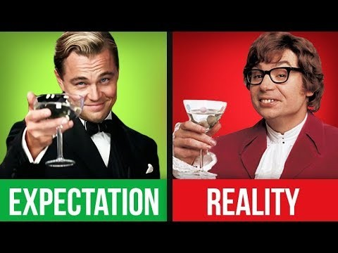

Slide 10


Slide 11


Slide 12


Slide 13
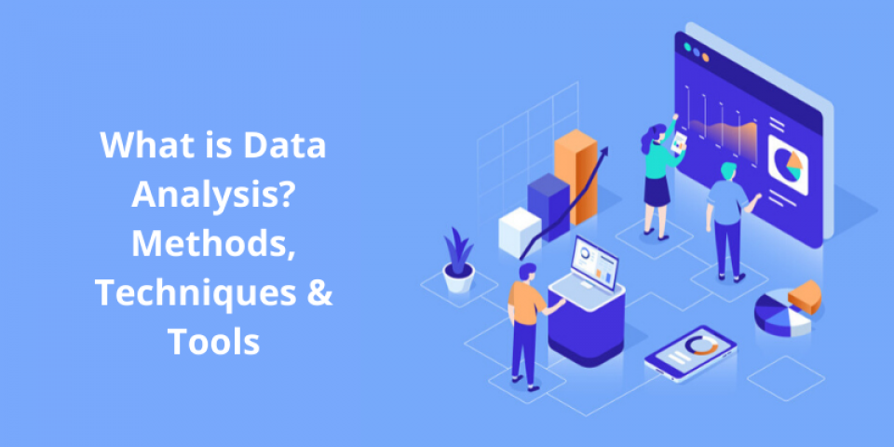
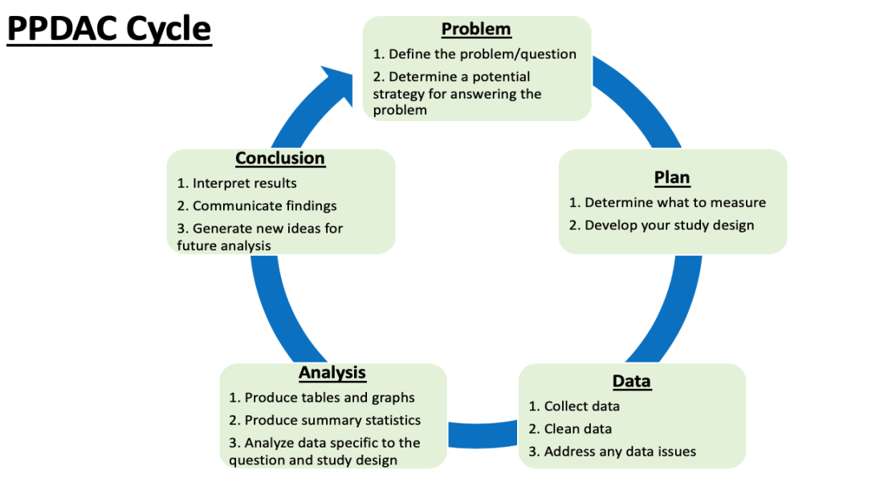
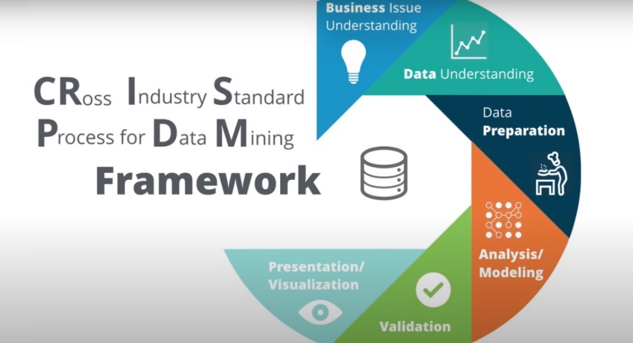

Slide 14
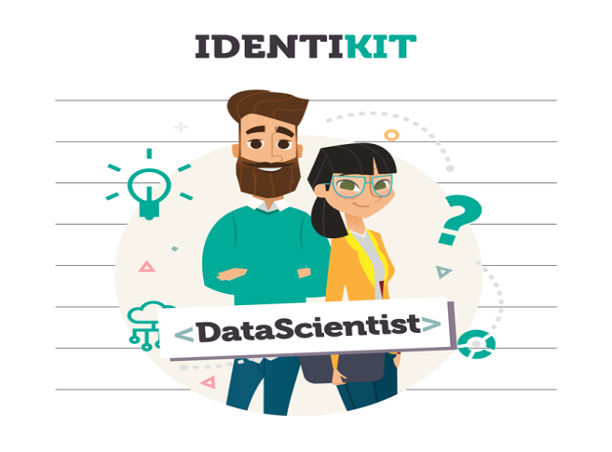

Slide 15


Slide 16



Slide 17
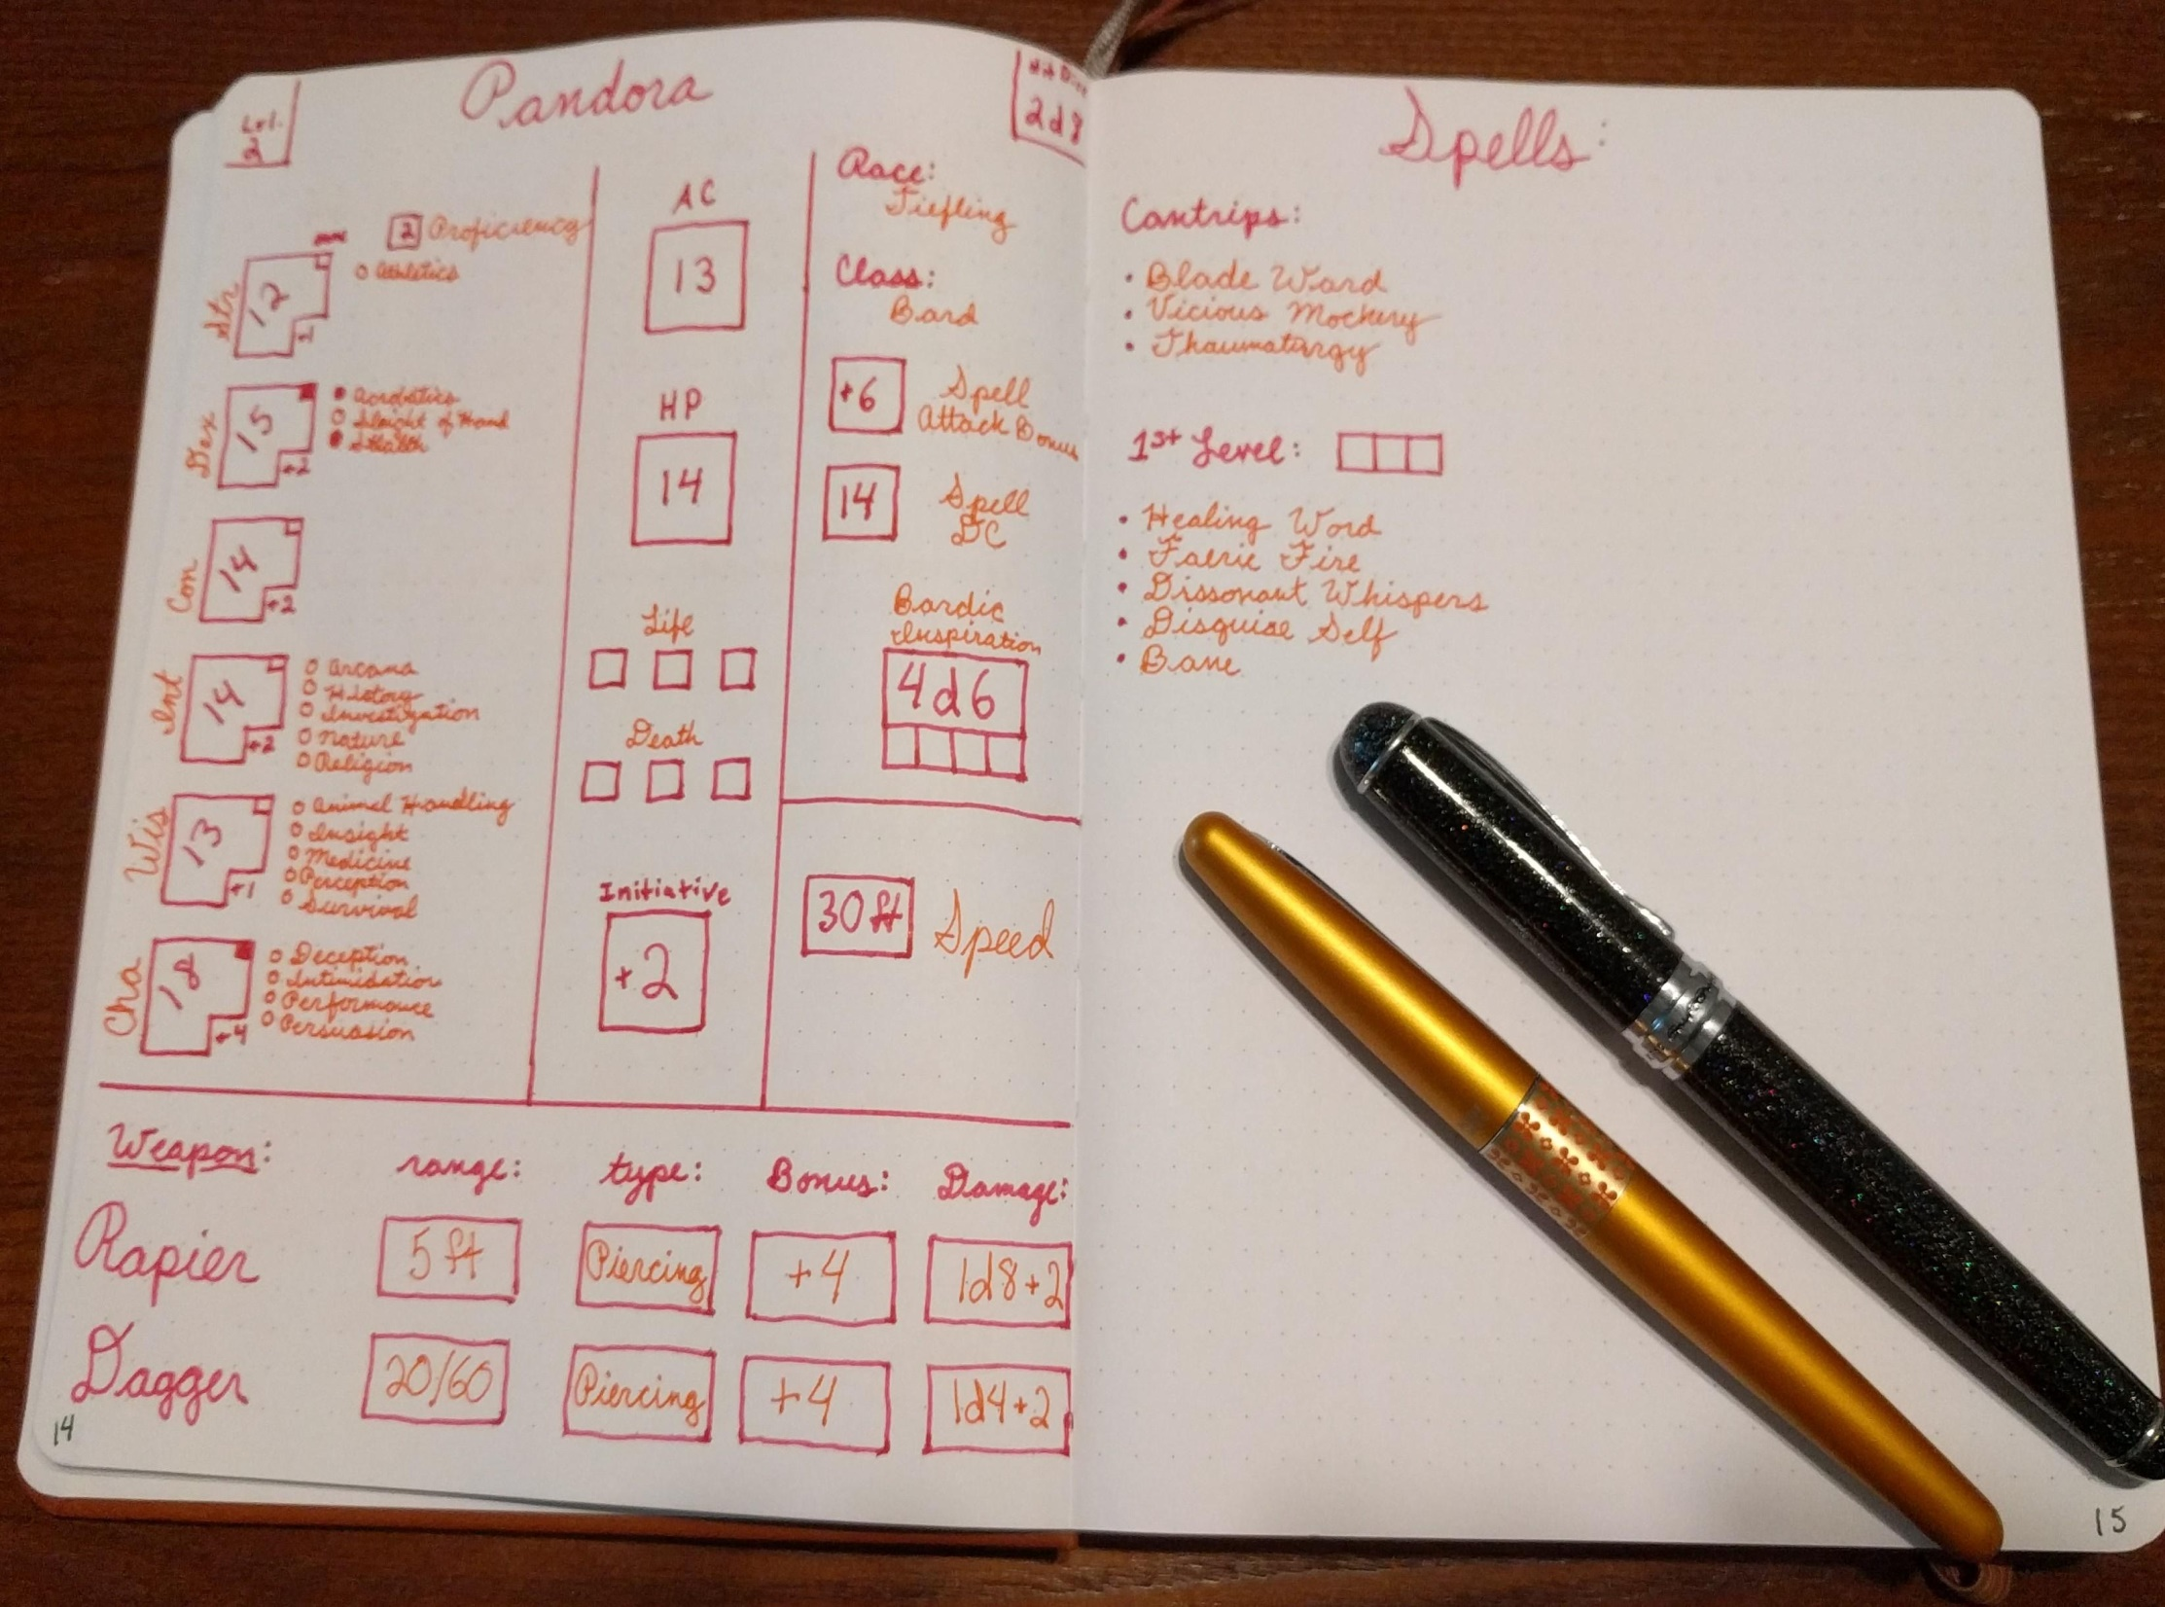

Slide 18

Business &
Market
Understanding

Slide 19

Business
Partnering
Notes:
Business partnering

Slide 20

Technical
Mastery

Slide 21
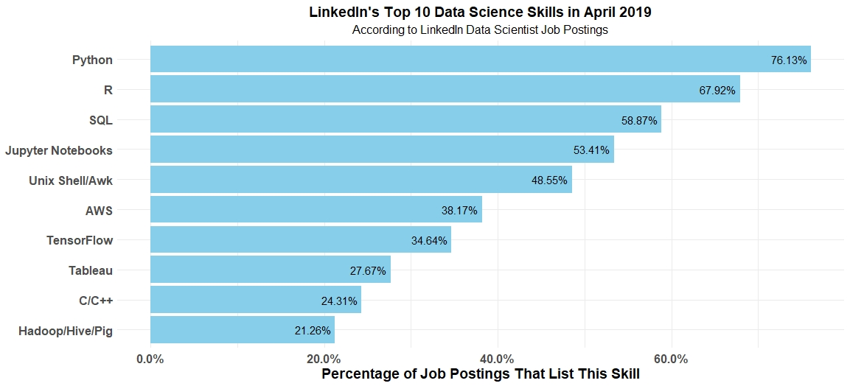

Slide 22
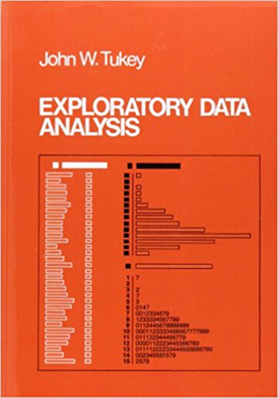
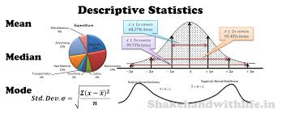
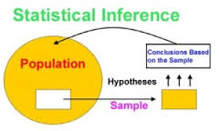


Slide 23

Generating
Exceptional
Insights

Slide 24

Synthesis &
Communication

Slide 25






Slide 26

Common sense
Is not so common
Voltaire

Slide 27
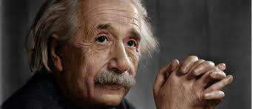
I have no special talents.
I am only passionately curious
Albert Einstein

Slide 28
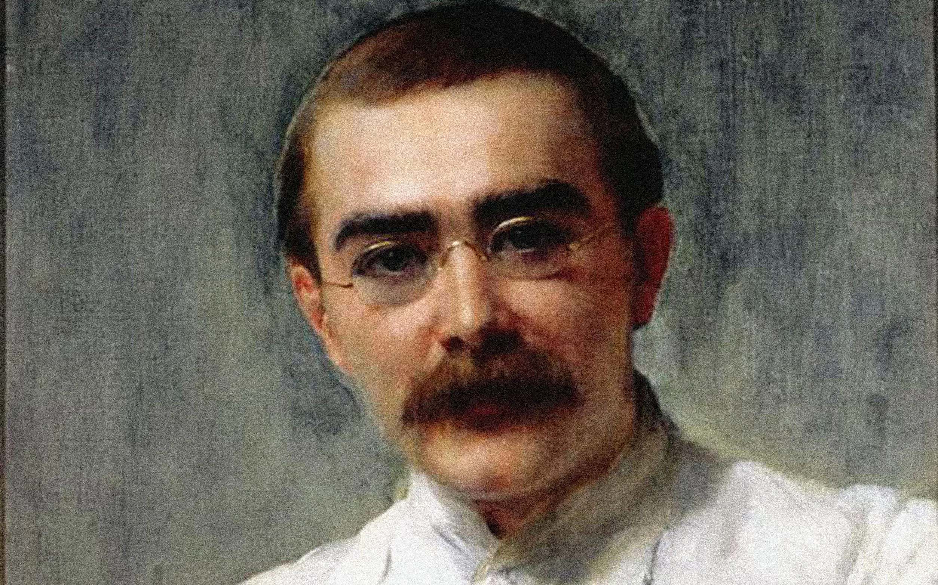
Words are, of course, the most powerful drug used by mankind.
If history were taught in the form of stories, it would never be forgotten.
Ruyard Kipling

Slide 29

Think left and think right
And think low and think high.
Oh the thinks you can think up if only you try
Dr Seuss

Slide 30


Notes:
James Kerr book Legacy
I can technical, there is as far as I know no cure for being a bellend

Slide 31


Slide 32


